Slide 1
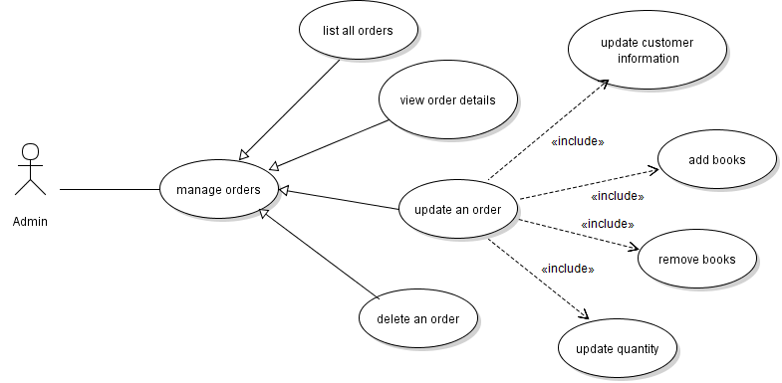
Code Order Management Module

Slide 2
Code Order Management
Update Order:
Update shipping information
Update quantities of books
Remove books from order
Add books to order
Delete Order

Slide 3
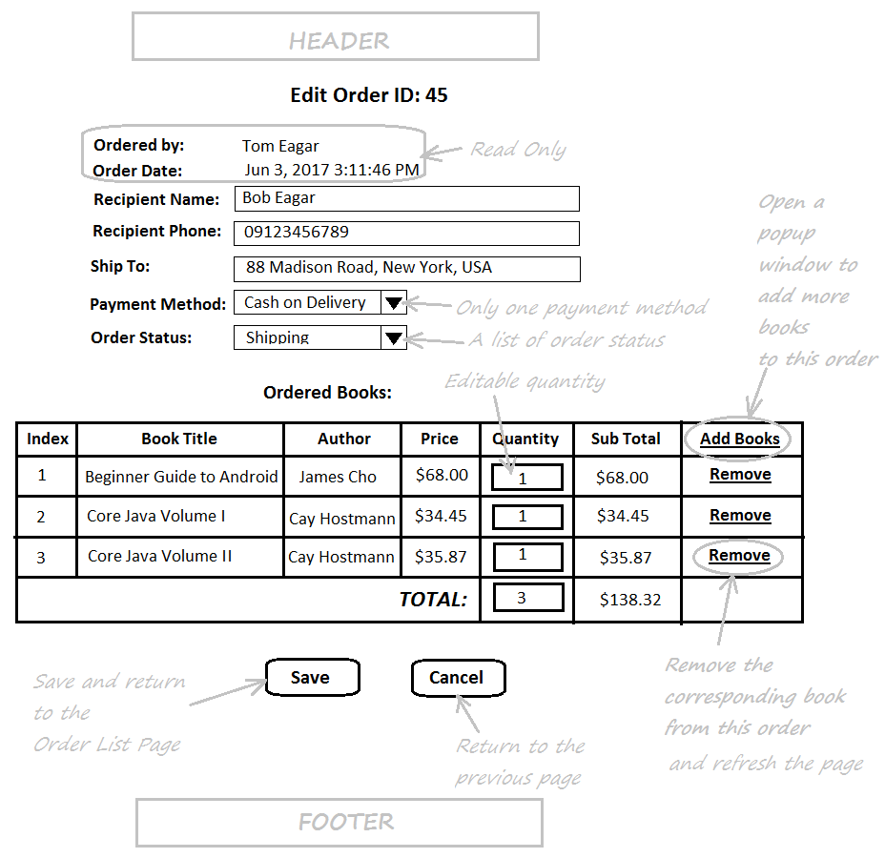
Code Update Order Feature

Slide 4
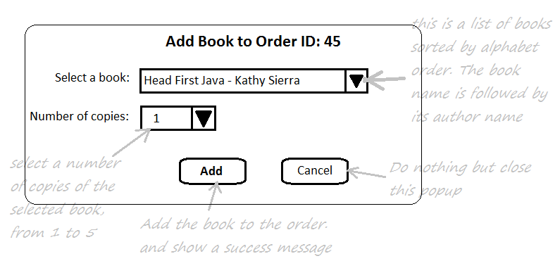
Add Book to Order Popup Dialog

Slide 5
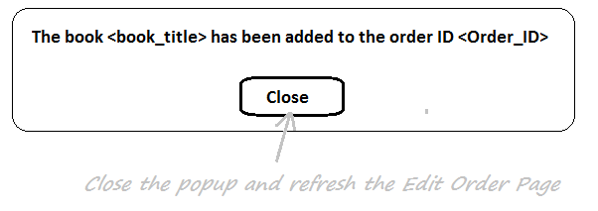
Add Book to Order Successful Message

Slide 6
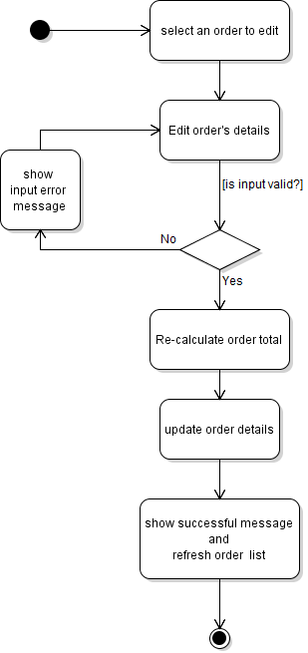
Activity Diagram: Update Order

Slide 7
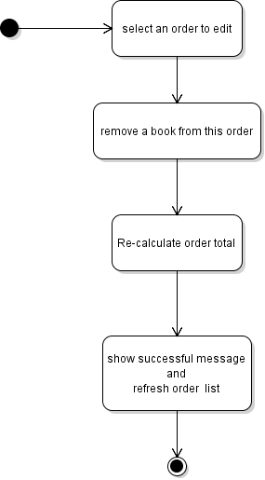
Activity Diagram: Remove book from order

Slide 8
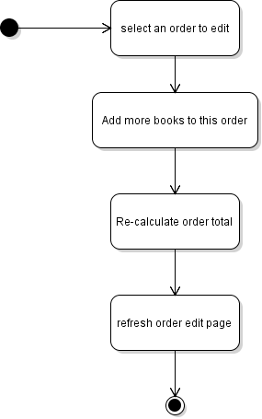
Activity Diagram: Add book to order

Slide 9
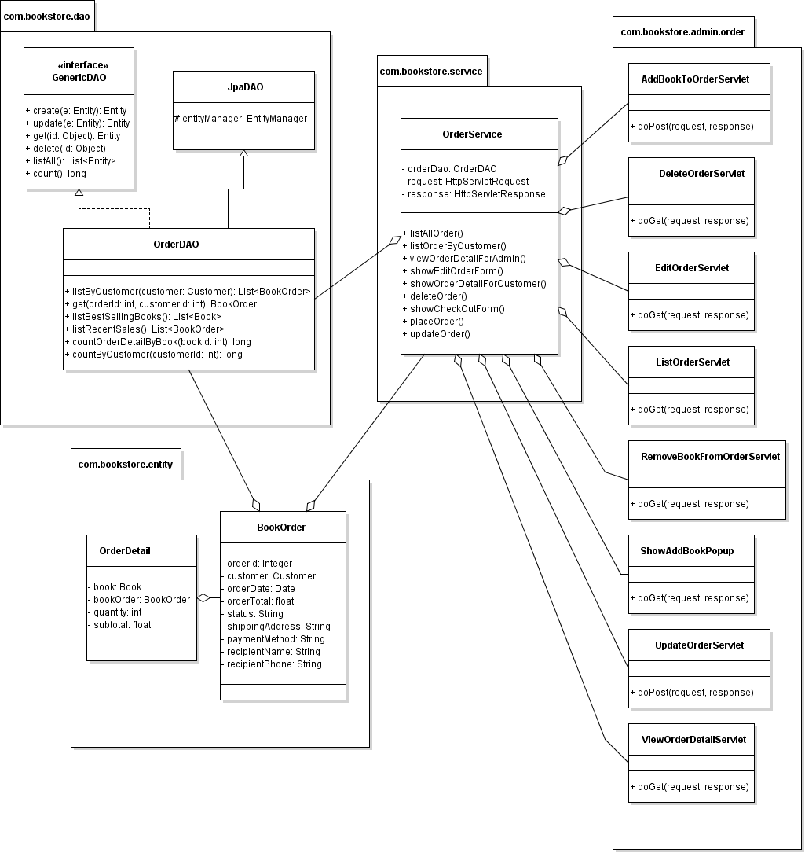
Class Diagram

Slide 10
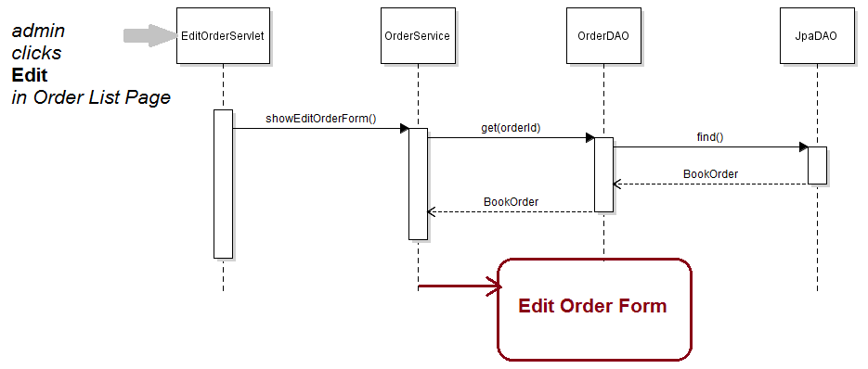
Sequence diagram: edit order

Slide 11
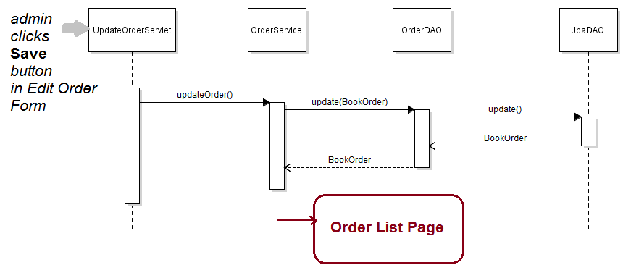
Sequence Diagram: Update Order

Slide 12
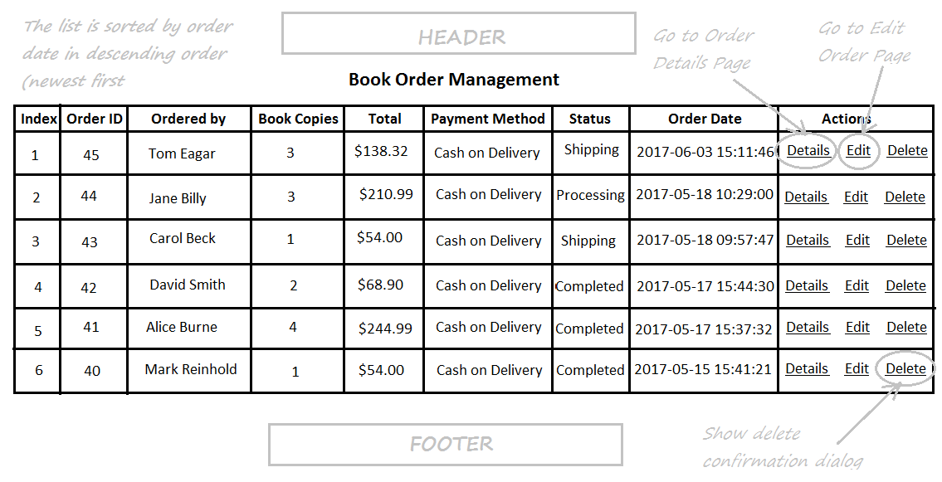
Code Delete Order Feature

Slide 13
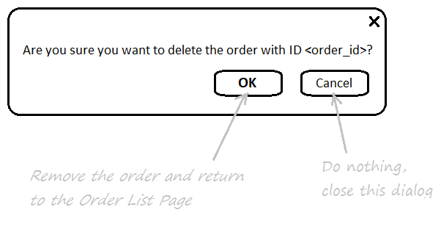
Delete Order Confirmation Dialog

Slide 14
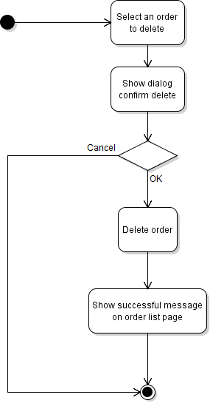
Activity Diagram: Delete Order

Slide 15
Class Diagram

Slide 16
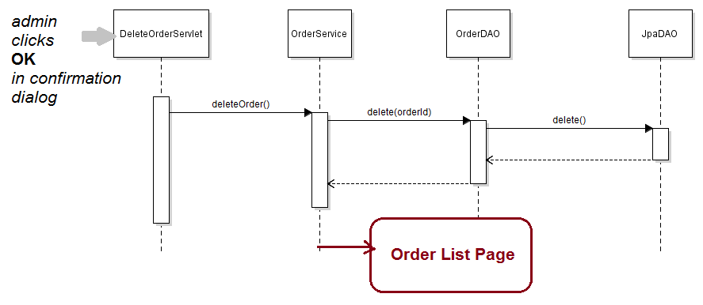
Sequence Diagram: Delete Order

